Slide 1

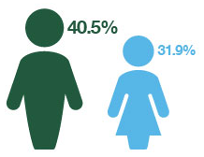
Grange Farm Youth Club
Period: Financial Year 2018-2019
Unique attendance
Attendance by Gender
Number of
sessions delivered
in the period
Weekly session
Every Wednesday
09 May
25 April
18 April
11 April
04 April
43.9%
34.2%
5
41
21 young people attended only one session, while 3 young people attended the 5 sessions
Prefer not to say 21.95%
Attendance by Ethnicity | %
Preferred Not to Say | 43.90%
Black or Black British - African | 26.83%
Mixed - Other | 7.32%
White British | 7.32%
Asian or Asian British - Other | 4.88%
Asian or Asian British - Afghan | 2.44%
Black or Black British - Caribbean | 2.44%
White - European or Other | 2.44%
White - Irish | 2.44%
Prefer not to say 56.10%

Slide 2
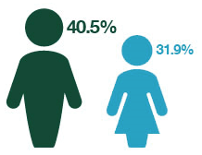
Grange Farm Youth Club
Period: Financial Year 2017-2018
Unique attendance
Attendance by Gender
Number of
sessions delivered
in the period
Weekly session
Every Wednesday
21 March
14 March
06 December
29 November
22 November
15 November
08 November
61.9%
38.1%
7
21
17 young people attended only one session, while 2 young people attended the 5 sessions
Attendance by Ethnicity | %
Preferred Not to Say | 95.24%
Asian or Asian British - Pakistani | 4.76%
Prefer not to say 56.10%

